Slide 1
Process Control:
Fundamentals of Process Modeling and Identification
Cai Wenjian, Contact: Tel: (65) 6790-6862, E-mail: ewjcai@ntu.edu.sg
Process Control
Dr. Cai Wenjian

Slide 2
Objectives:
Understanding of issues related Basic control algorithms, Advanced control strategies, Multivariable control, Plant parameter estimation and Process modelling and simulation.
Case studies in process control system to enhance skills and techniques for tackling practical process control system design problems.
Desired outcomes: should be able to handle tasks on modelling, analysis, design and implementation of control systems for the continuous process industry
Process Control
Dr. Cai Wenjian

Slide 3
Assessment Scheme
CA Components (20%) | Final Exam
2 x 10% (Total: 20%) | 80%
Process Control
Prof. Cai Wenjian

Slide 4
Assessment Scheme
CA Components (20%) | Final Exam
2 x 10% (Total: 20%) | 80%
Process Control
Prof. Cai Wenjian

Slide 5
Chapter 1 Fundamentals of Process Modeling and Identification
Please self reading to understand fundamentals of parameter estimation
Process Control
Prof. Cai Wenjian

Slide 6
Process Control:
Identification from Step Response
Process Control
Dr. Cai Wenjian

Slide 7
Outline
Parameter Identification from Step Response
  Theoretical Step-Response Expressions
  Classical methods for open loop step test
    Log Method
    Two Points Method
    Area Method
  Least Squares Methods
  Closed-Loop step test
  Least squares method for system under PID control
    Recursive Solution
    Transfer function modeling
Process Control
Dr. Cai Wenjian

Slide 8
Basic Requirement
Obtain process model from a transient response experiment.
    inject step input at the process
    measure response
Requirement:
    stable process
Amplitude of step signal must be set a pripori
    sufficiently large so response is easily visible above noise level
    as small as possible
      not to disturb the process more than necessary
      keep the dynamics linear.
Process Control
Dr. Cai Wenjian

Slide 9

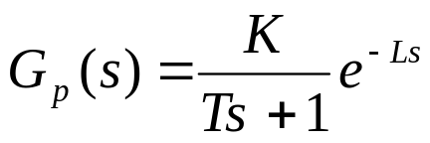
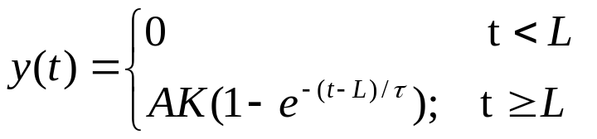
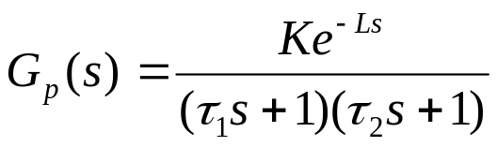
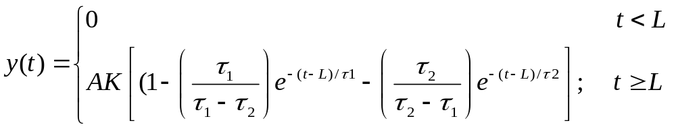
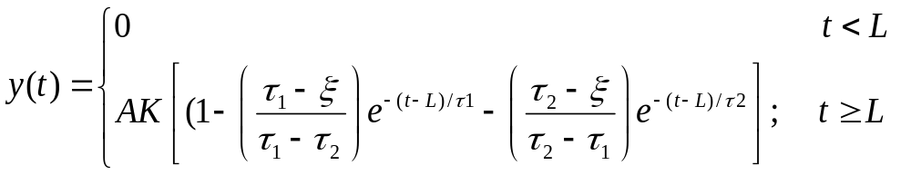
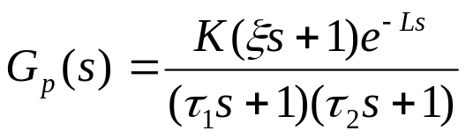
Theoretical Step-Response Expressions
Both T and
First-order-plus-time-delay
Parameters: K, τ, L.
Represent time constant
Second-order-plus-time-delay
Parameters: K, τ₁, τ₂, L.
Single zero, two poles, plus time delay
Parameters: K, τ₁, ξ, τ₂, L.
Process Control
Dr. Cai Wenjian

Slide 10
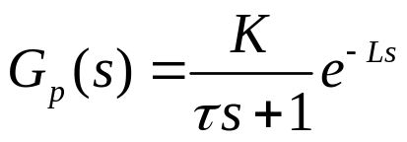

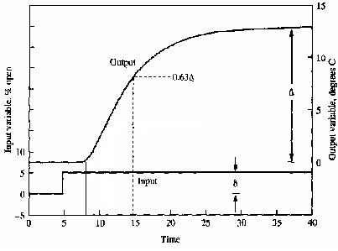
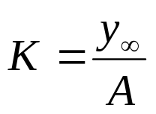
Fundamentals
when times greater than the time delay
steady-state gain
Time Constant τ
Time Delay L:
Process Control
Prof. Cai Wenjian

Slide 11
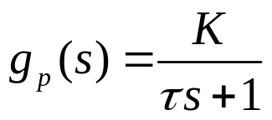

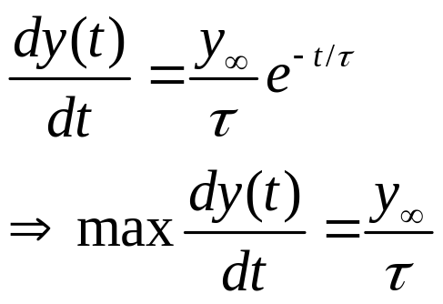
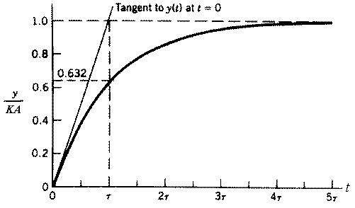

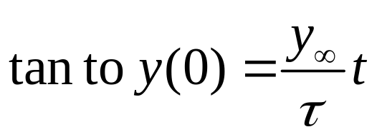
Graphic Method
steady-state gain
Time Constant
Deepest Slop
Process Control
Prof. Cai Wenjian

Slide 12
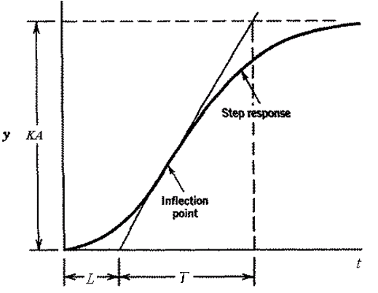

Graphic Method
when times greater than the time delay
steady-state gain
Time Constant
Time Delay L:
Process Control
Prof. Cai Wenjian

Slide 13
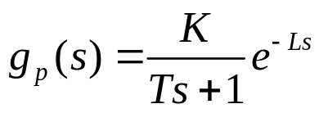
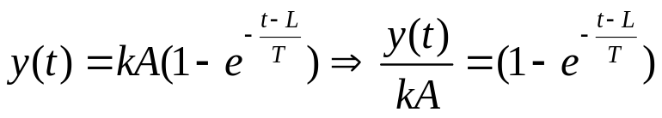

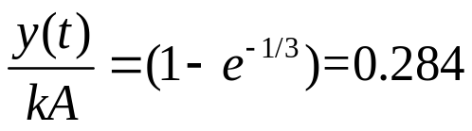
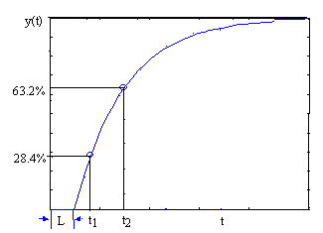


Two Points Method
Process model and step response, when
y(∞)%
28.4
39.3
55
59.3
63.2
77.7
86.5
time(t)
T/3+L
T/2+L
0.8T+L
0.9T+L
T+L
1.5T+L
2T+L
t₁ and t₂, the time when response with value 28.4% and 63.2%
t₁= T/3+L
t₂=T+L
Process Control
Prof. Cai Wenjian

Slide 14


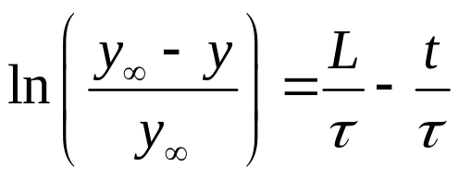
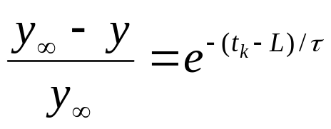
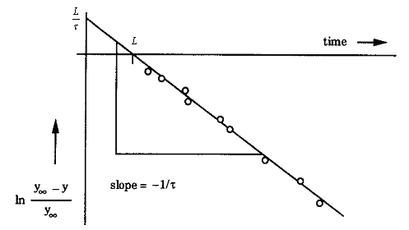
Log Method
First order process when times greater than the time delay
estimate of the steady-state gain
Time Constant τ and Time Delay L:
Plot against t: a straight line with
  slope of -1 /τ,
  intercept y-axis at L /τ.
  meet the t-axis at the point t = L.
estimates of parameters graphically.
Process Control
Dr. Cai Wenjian

Slide 15
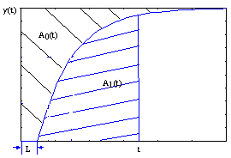
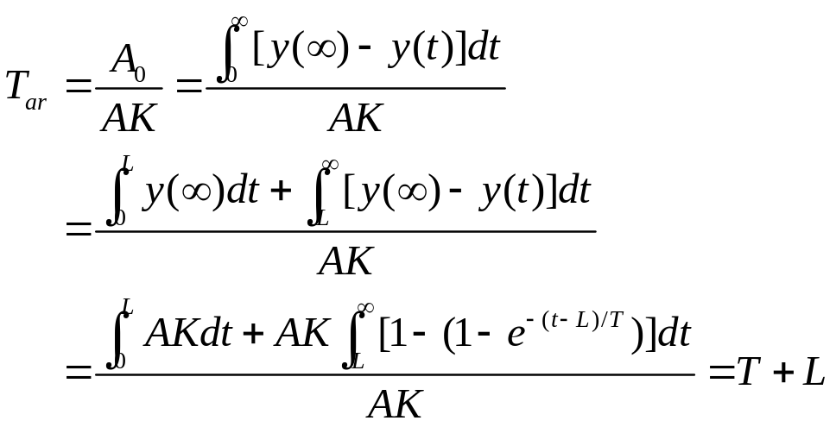
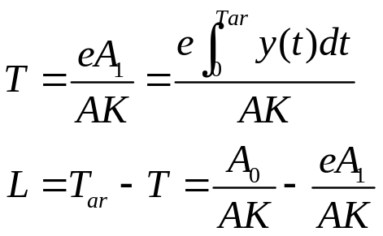
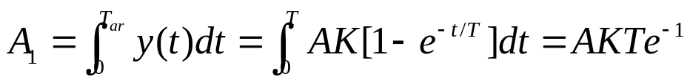
Area Method
Average residence time T_{ar} computed form the area of A₀
Measure and compute area A₁ under step up to the time T_{ar}
T and L can be estimated as
Process Control
Dr. Cai Wenjian

Slide 16
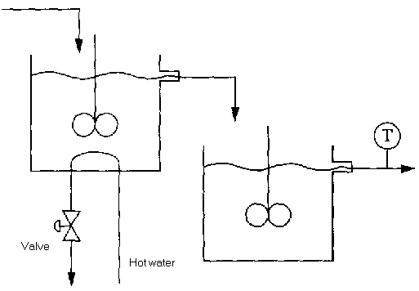
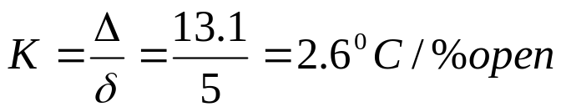




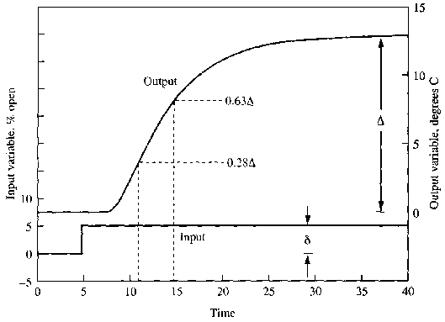

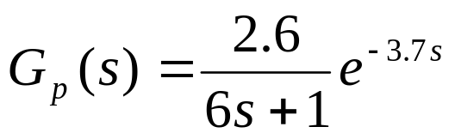
Example: Stirred Tank
The model
Process Control
Dr. Cai Wenjian

Slide 17
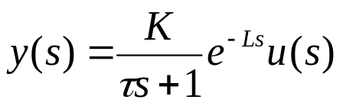
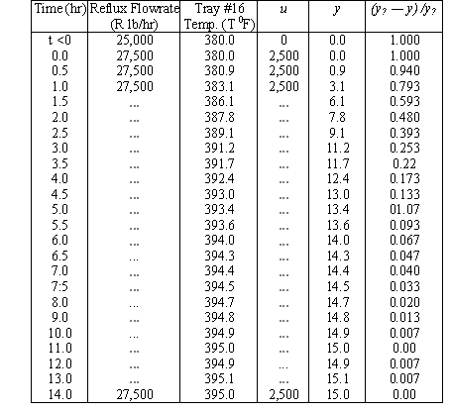

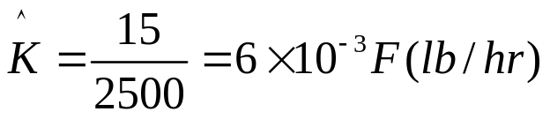
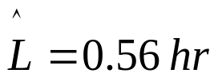
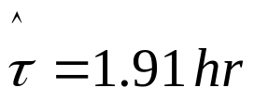
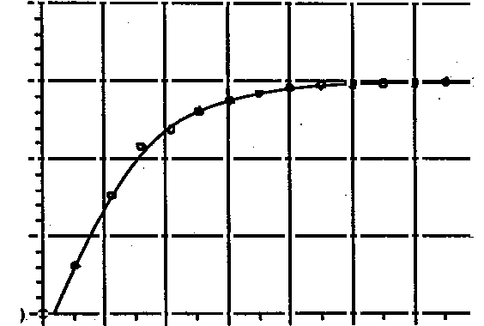
Example: Distillation Column
Temperature regulated by flowrate, model
Log Method:
Process Control
Dr. Cai Wenjian

Slide 18
Problems of Classical Methods
Only for open loop
Sensitive to noise, disturbance, less accurate
Perturb the process more than necessary
Take long time to perform the test
Etc.
Process Control
Dr. Cai Wenjian

Slide 19
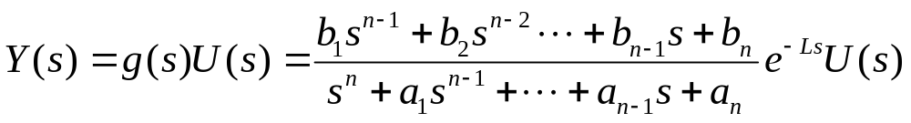
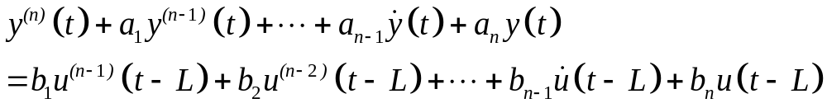
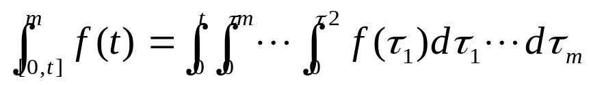
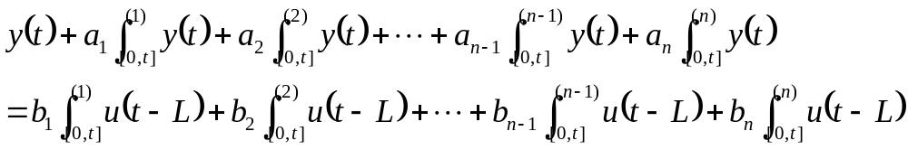
Principle of Least Square Method
Process
define
Integrating n times, yields
Process Control
Dr. Cai Wenjian

Slide 20
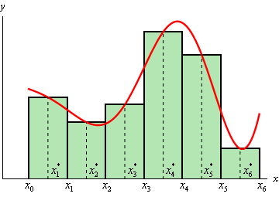

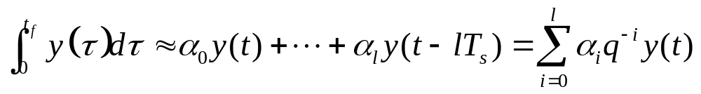


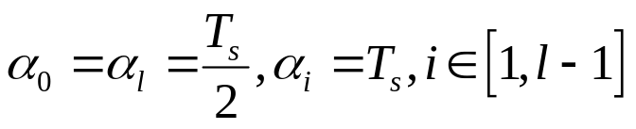
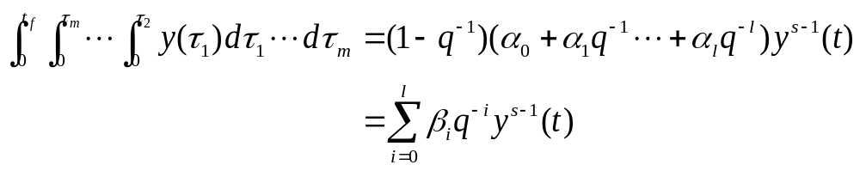
Integration
Integral of a continuous time signal over
T_{s}: integration step size, l: length factor of the integrator
unit delay operator,
How many point should be taken?
For trapezoidal integration rule, the filter coefficients are given as:
sth multiple integral of y(t)
Process Control
Dr. Cai Wenjian

Slide 21
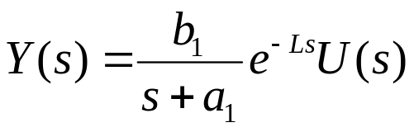

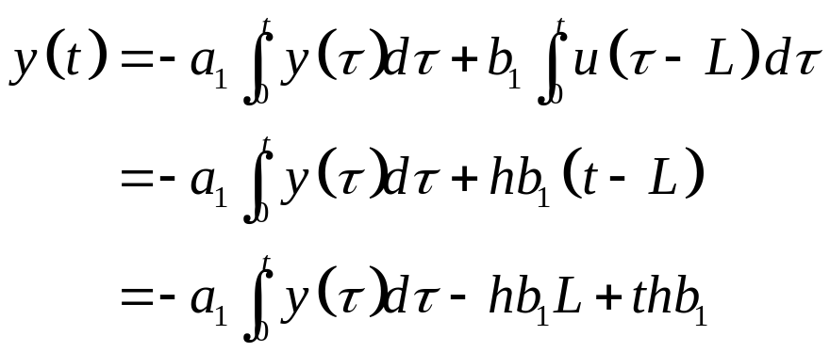
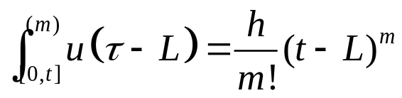
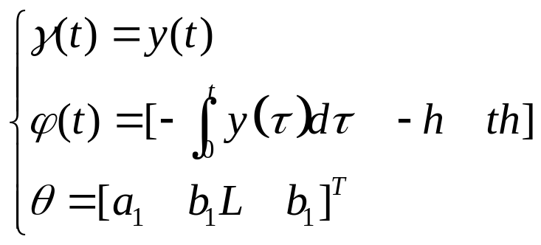

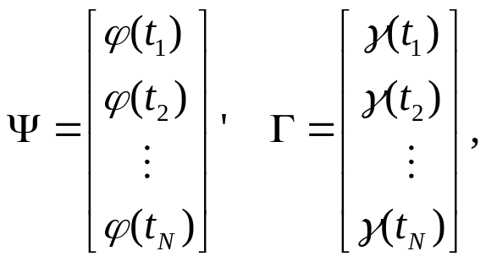
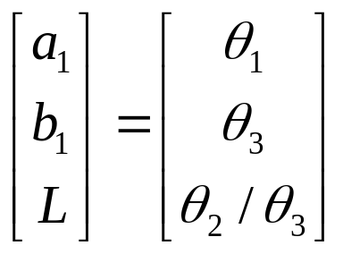

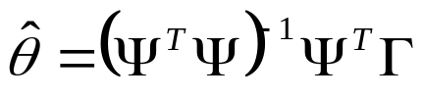
FOPTD Process
For
Define
For N samples
Process Control
Dr. Cai Wenjian

Slide 22







Second-Order Process
Process Control
Dr. Cai Wenjian

Slide 23




Example
Taking responses from t=0s to t=4.14s, y(4.14s)=0.95, estimated process model
Area method, process enters the new steady-state, with y(8.28s)=0.999, model is
If t=0 t0 t=4.14s used in area method
The Least Squares method saves a half to a third of testing time, gives better result.
Process Control
Dr. Cai Wenjian

Slide 24




Closed-Loop Identification Time-domain
Process Control
Dr. Cai Wenjian

Slide 25


Closed-Loop Identification Time-domain
Using first-order Taylor expansion for the unknown time delays, i.e.
Then
Process Control
Dr. Cai Wenjian

Slide 26







FOPTD Process
Process Control
Dr. Cai Wenjian

Slide 27








Signal Decomposition
Laplace transform defined as:
If two steady states are different in values or not back to zero, Fourier analysis cannot deal directly since they are not absolutely integrable
Decompose
Absolutely integrable
Step function
Then
Process Control
Dr. Cai Wenjian

Slide 28



Fourier analysis
At a given frequency point
integral over the time interval
Using the numerical integration method
For trapezoidal integration rule:
Process Control
Dr. Cai Wenjian

Slide 29






Open Loop
The transfer function
For
For step input
Process Control
Dr. Cai Wenjian

Slide 30








Process Model Under PID Control
using steady-state,
Process Control
Dr. Cai Wenjian

Slide 31




Recursive Solution
For the response curve, taking N samples from one steady state to the new steady state, calculate
for given
Process Control
Dr. Cai Wenjian

Slide 32














Recursive Solution
For initial values
are zeros
calculate
Obtain the frequency by
(close to the desired frequency)
calculate
For
and
Process Control
Dr. Cai Wenjian

Slide 33



Model Formulation
Second-order plus dead-time model
By matching multiple points
Magnitude conditions
Phase conditions
Process Control
Dr. Cai Wenjian

Slide 34






Magnitude Condition
Process Control
Dr. Cai Wenjian

Slide 35

Phase Condition
L again can be obtained using the least-squares method
Process Control
Dr. Cai Wenjian

Slide 36




Example: Open loop Test
Non-minimum-phase plus delay process
M =10, 20% NSR
Process Control
Dr. Cai Wenjian

Slide 37




Example: Closed loop Test
M =10
Process Control
Dr. Cai Wenjian

